Slide 1
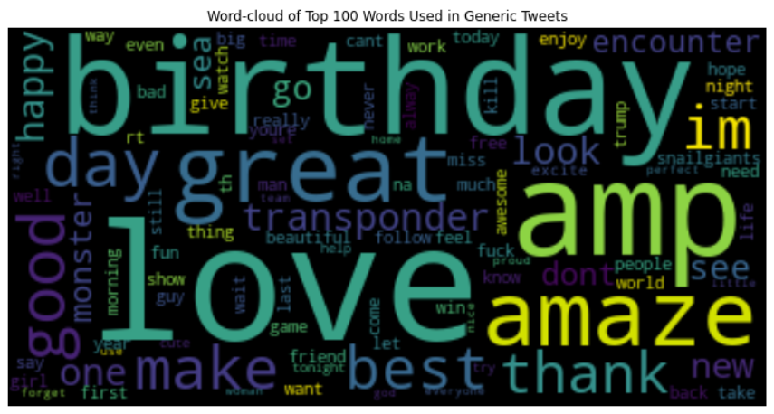
Exploratory analysis
The image indicates the frequency of words being used by size among all the generic tweets.
As the graph shows, most of the most frequent use words have positive meaning in most cases

Slide 2
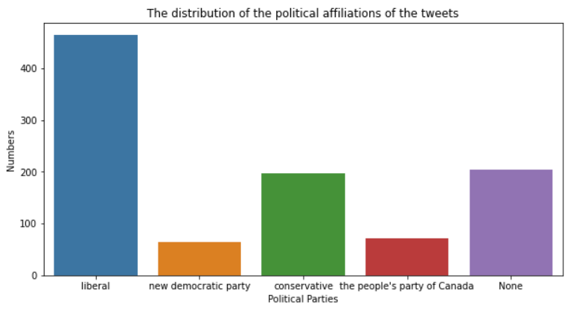
Exploratory analysis
This graph is the count plot of the different political affiliations of the tweets during 2021.
The Liberal and the Conservative has the most counts in the first and the second place, which aligns with the votes rank in 2021.
A huge part in distribution is recognized as None. It indicates that huge amount of tweets doesn’t want to show their political affiliations.

